Slide 1
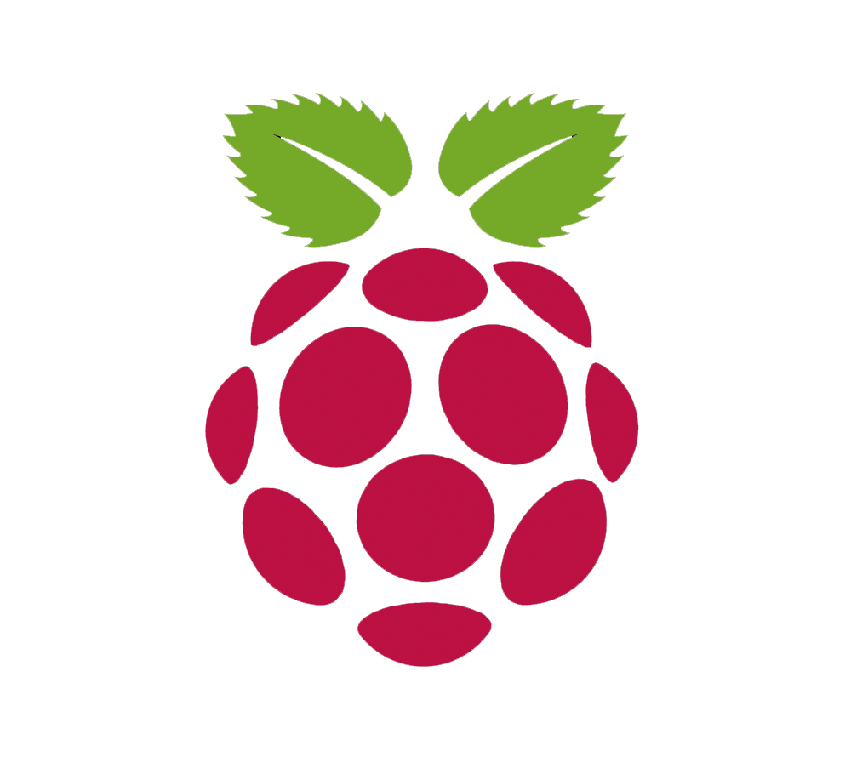
Iwiggle: robot follower
Andrey Pak
Donatas Kozlovskis
Enric Cornellà
Fernando Garcia
Igor Péric

Slide 2
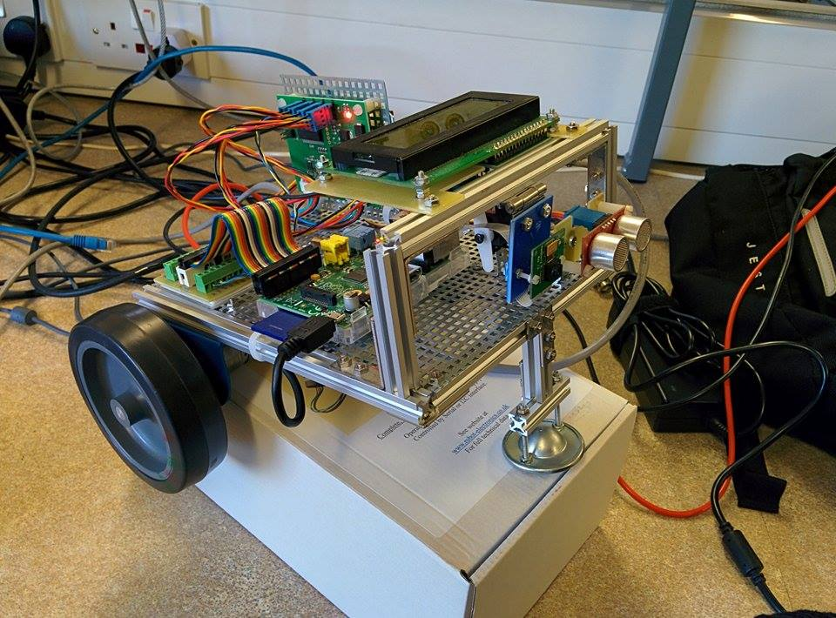
introduction
Educational purposes robot
Allow physical interaction using signs
Intuitive and friendly
Allow playing predefined games
Notes:
Not commercial product, just a collection of hardware connected together on a raspberry pi as a main board.
At the end, it is a long term project with the goal to create educational purposes robot,
And our task in this project to investigate if it is possible and make robot which is able to follow signs like (arrows, crosses) on a surface using given hardware
Since it should be an education robot, the interaction should be as much as possible user friendly
With and the end allow to develop simple games for children who can help a robot, e.g. reach the goal or exit the labyrinth.

Slide 3
objectives
Read colored markers on the floor
Implement the associated actions: stop, go to, turn…
Review the hardware design
Implement controller for sensors and actuators
Image processing module in C++ and OpenCV
Robust and real-time solution
Notes:
In more details, our project objectives can be divided into following tasks:
To be able to read colored markers
After recognition create an corresponding actions as stop,go turn
Check hardware design and
Implement controllers,
On top of that for recognition we need image processing module which at the end should be real time solution to interact directly with children

Slide 4
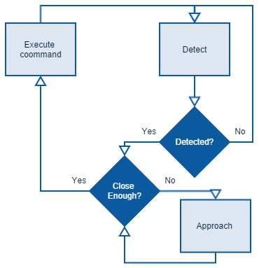
Case scenario
Notes:
Shortly,
We can present you a case scenario of initial robot algorithm,
We would start from detection and recognition of defined sign
When it is detected robot should be close enough the sign, or approach to it
and finally executed the detected command,
The goal is to loop until the the stop sign is detected

Slide 5
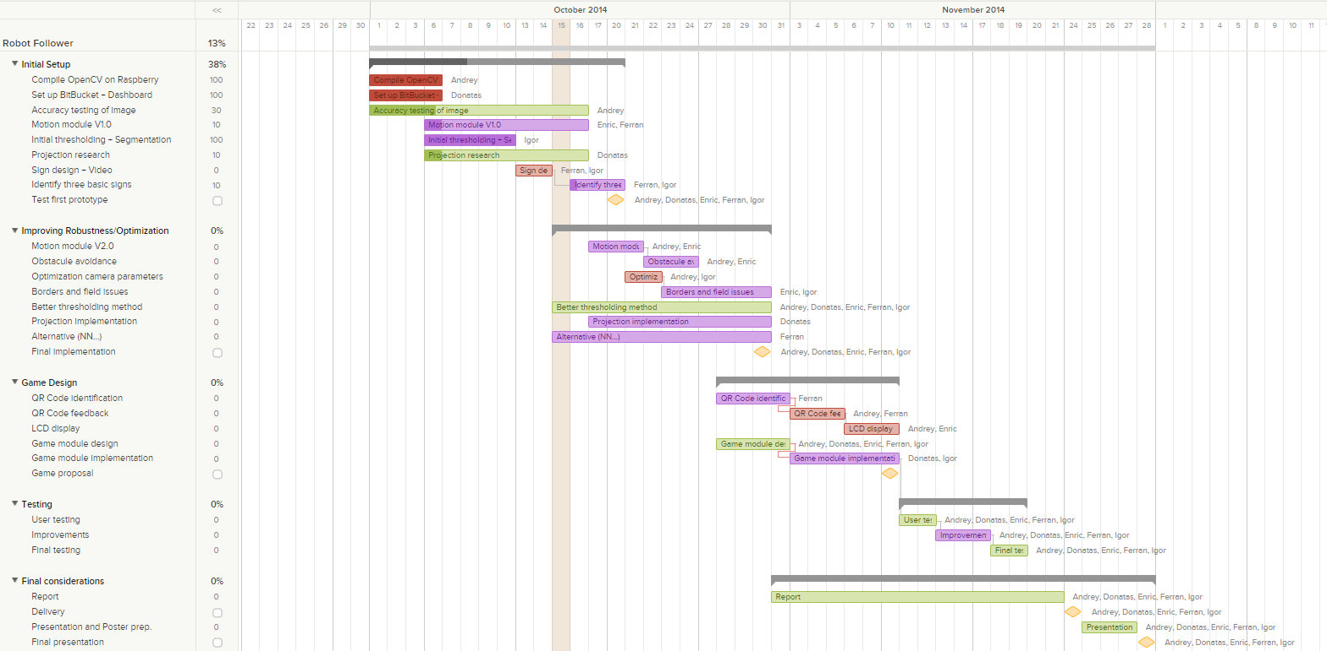
Project Planning
Notes:
A Gantt->that illustrates a project schedule.
Start and finish dates of the terminal elements and summary elements of a project.
5 main steps

Slide 6


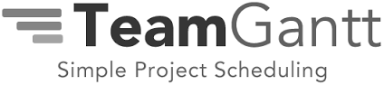
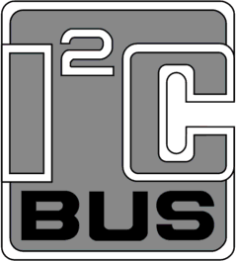
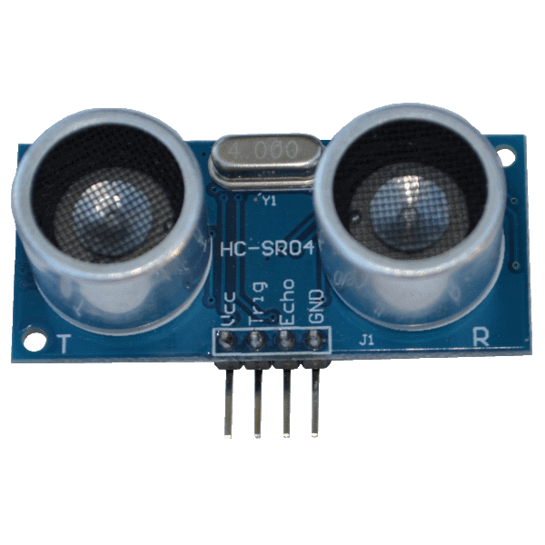
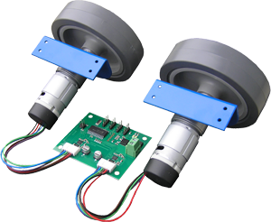
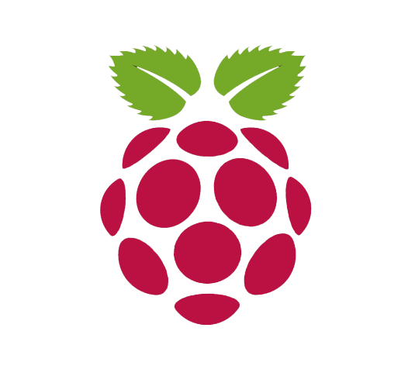
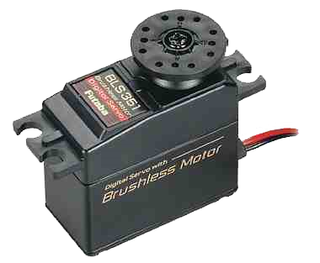
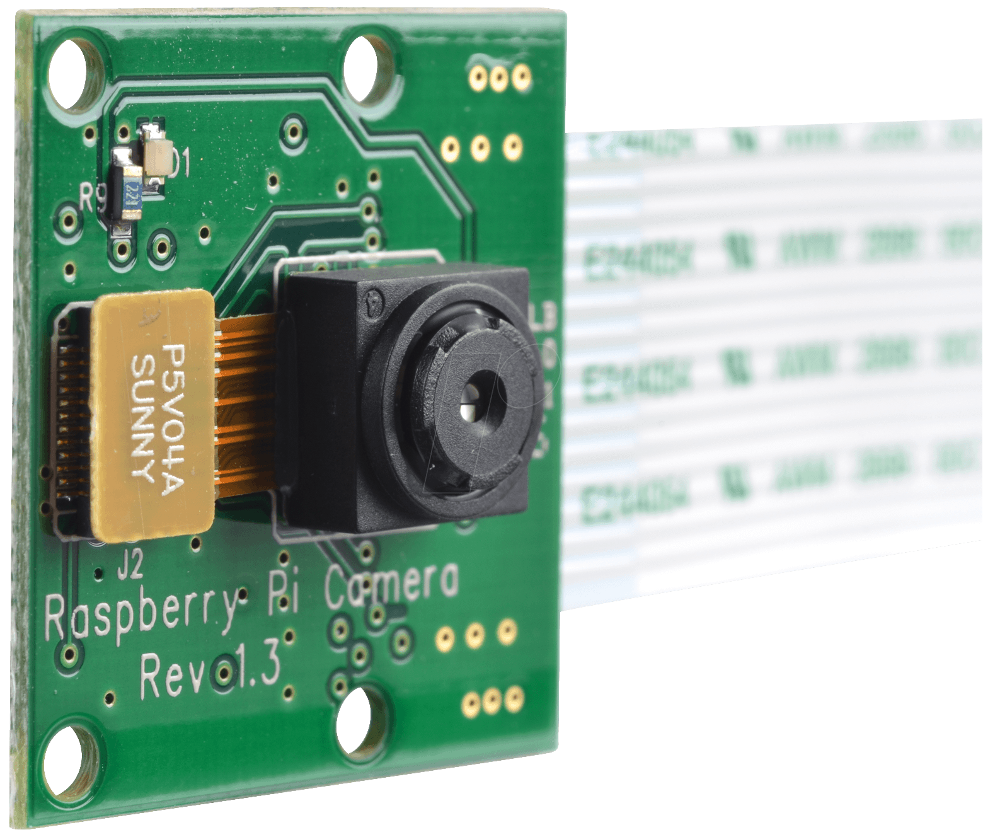
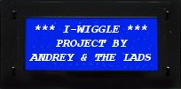
Resources and Hardware
Notes:
Source control
Issue tracker, Projects are represented by boards, which contain lists. Lists contain cards (corresponding to tasks). Cards are supposed to progress from one list to the next (via drag-and-drop),
Help, plan, organize, and manage resource pools and develop resource estimates.

Slide 7
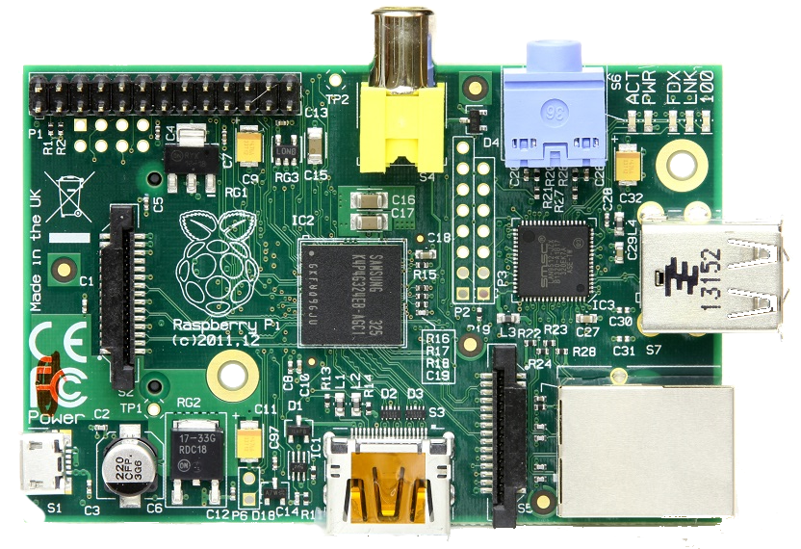
Raspberry pi performance
OS | Linux
CPU | ARM11 BCM283 700Mhz
RAM | 512 Mb
Interfaces | 2xUSB, HDMI, LAN, UART, GPIO (JTAG, SPI, I2C), DSI
Memory | SD Card
Resolution | Raspberry Pi + PiCamera (CPU) in fps | Raspberry Pi + Logitech C270 (CPU) in fps
160x120 | 20 | 9
320x240 | 6.5 | 4.8
640x480 | 2.5 | 2.3
1280x720 | 0.6 | 0.6
Notes:
Andrey
Raspberry Pi is credit-card sized System-on-Chip (SoC) design computer. There are several variants of this board – models A, B and B+.
We are using Raspberry Pi Model B.
It uses ARM11 700 MHz CPU that can be overclocked up to 1GHz.
It also contains 28 General Purpose Input-Output (GPIO) ports that provide the usage of such interfaces as I2C, UART, SPI.
There are several Linux distributions suited for the board.
The performance of the sign detection varies depending on the hardware used. We have tested two boards and two cameras in the program.
We tried Logitech C270 Webcam on both of the boards, however the usage of the PiCamera is limited to the Raspberry Pi only (DSI interface).
Raspberry Pi Camera module provides some benefits compared to using the web camera.
An increase of FPS is obtained by resizing the image inside the hardware of the camera while for the USB camera, OpenCV is used to decrease the size of the frame
Everything was tested on the CPU.

Slide 8
Motion Module
If the direction is forward Mspeed1 = speed - turn Mspeed2 = speed + turn
Else the direction is reverse so Mspeed1 = speed + turn Mspeed2 = speed - turn
Notes:
Ferran

Slide 9
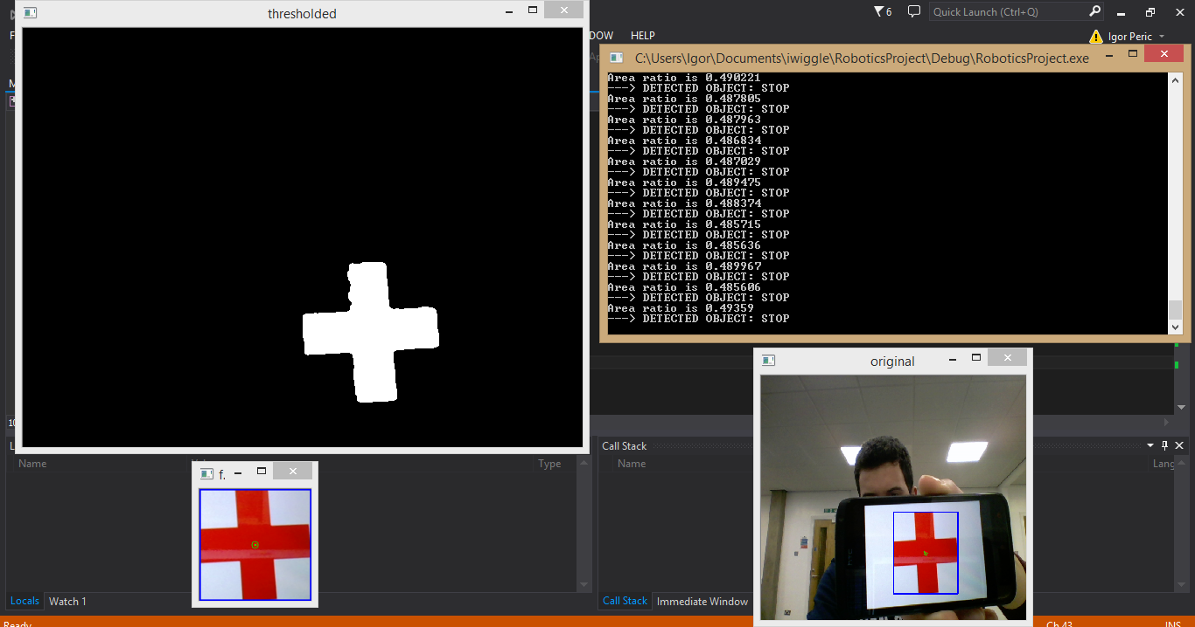
Sign classification I
Notes:
Igor
Computationaly non-expecive
Segmentation in HSV space

Slide 10
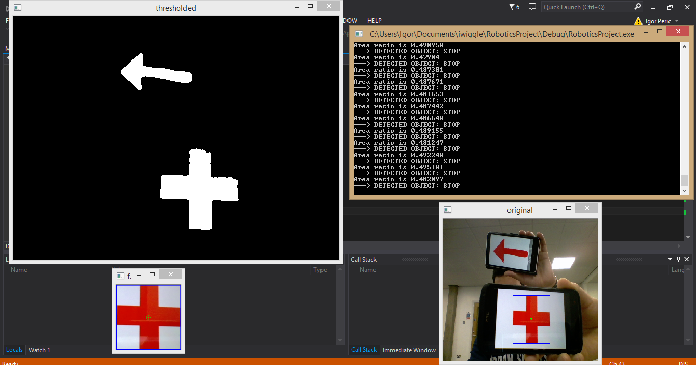
Sign classification II
Notes:
Igor
- Biggest blob

Slide 11
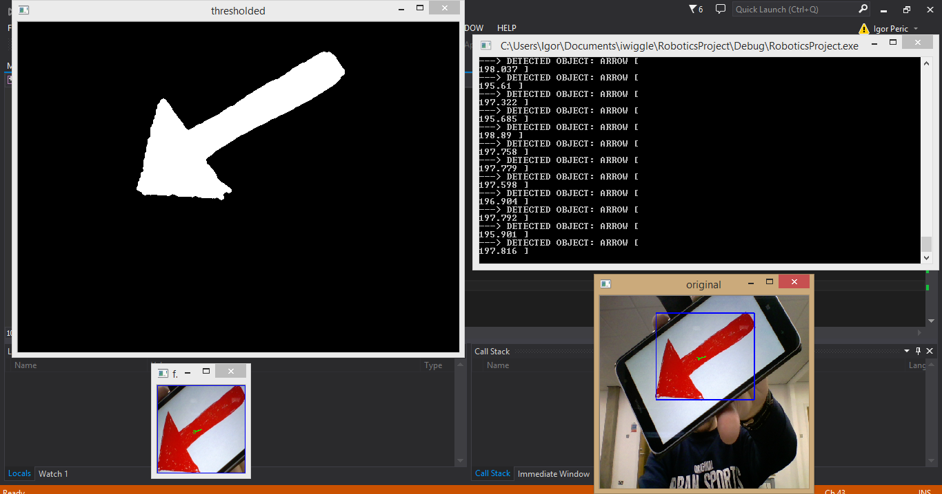
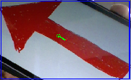
Vision module
Using statistical moments
Notes:
Igor
Differentiation of different type of the signs
Angle computation

Slide 12
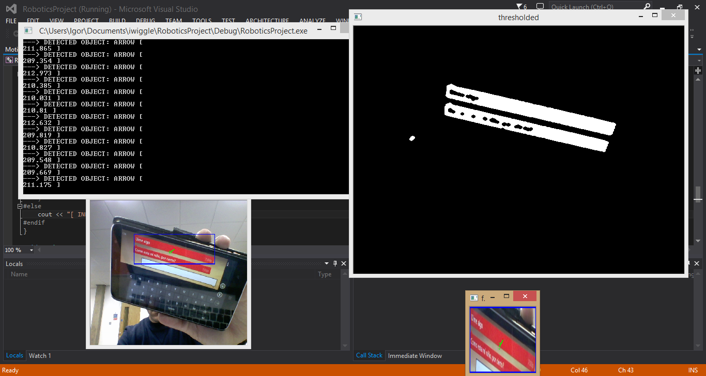
False positive
Notes:
Igor

Slide 13
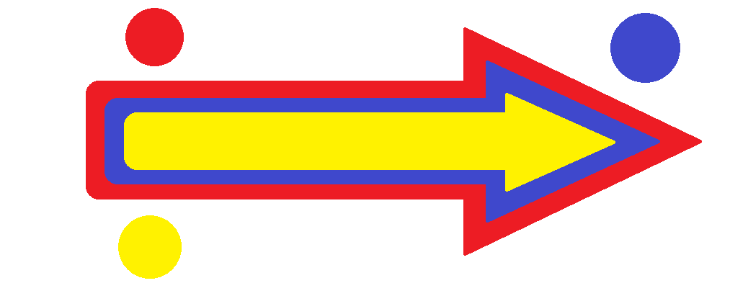


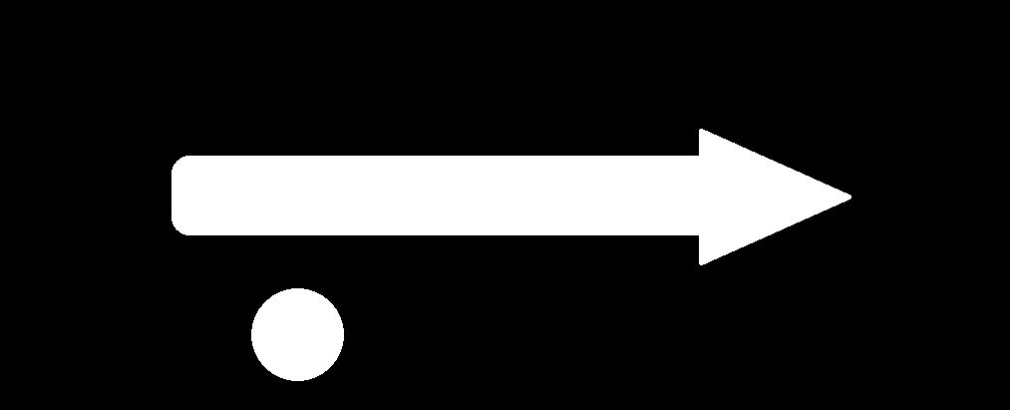
Potential improvement
Notes:
Igor

Slide 14

Limitations and issues
Limited development environment
Computational power
No simulator
Hardware and drivers
(video)
Notes:
Ferran
Compiling in windows does not work as in Raspbian
Limitation to only one robot -> Necessity of planification
Took more than 8h to compile openCV
Low frame rate and resolution in comparison with a laptop
Does not allow operation with high computational cost -> Optimization

Slide 15
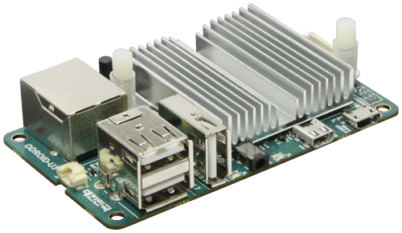
HARdware Improvements
ODROID-U3
Operating System | Linux, Android
CPU | Cortex-A9 1.7GHz Quad-Core
RAM | 2048Mb
GPU | Mali-400 Quad-Core
Interfaces | 3xUSB, HDMI, LAN, GPIO…
Resolution | Raspberry Pi + PiCamera (CPU) in fps | Raspberry Pi + Logitech C270 (CPU) in fps | Odroid + Logitech C270 (CPU) in fps
160x120 | 20 | 9 | 31
320x240 | 6.5 | 4.8 | 20
640x480 | 2.5 | 2.3 | 11
1280x720 | 0.6 | 0.6 | 4
Notes:
Andrey
One of the possible hardware improvements available is the Odroid-U3 board.
This is also a single-board computer that provides significantly greater performance.
Another advantage of this board is the usage of the eMMC memory cards that are capable of delivering up to 160 MB/sec reading speed.
The only disadvantage is the absence of the GPIO ports. It is necessary to use either the GPIO shield or USB adapter.
However, even with the USB Camera Odroid-U3 outperforms the Raspberry Pi.

Slide 16
Future work
Game implementation
QR Codes
Sound feedback
Notes:
Ferran

